Slide 1
Kidney Transplantation
Presented by Nebraska Medicine
Revision date: 11/11/2021

Slide 2
Agenda
Review treatment options for End-Stage Renal Disease (ESRD)
Review of kidney transplant options
Overview of the evaluation process
Care partner support
Review of the listing process
The surgery
Post-transplant
Transplant outcomes

Slide 3
Treatment Choices for ESRD
Medical Management
Hemodialysis
Peritoneal dialysis
Deceased donor kidney transplant
Living donor kidney transplant
Notes:
Dialysis: In-center hemodialysis, home hemodialysis, peritoneal dialysis

Slide 4
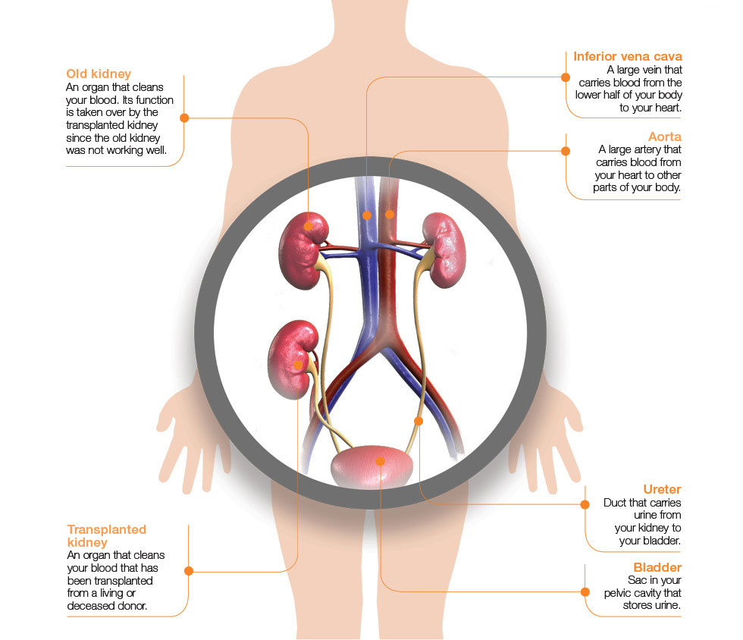
Benefits of Kidney Transplantation
Improved life expectancy
Decrease cardiovascular events (stroke, heart attack, etc)
Improve Quality of Life
Less expensive than dialysis

Slide 5
Quality of Life Considerations: Dialysis/Transplant
Dialysis:
Fatigue
Dietary/Fluid Restriction
Cramping
Nausea
Time Investment
Infections
Pain
Transplant:
The number of medications you take may increase or decrease
Pain/Recovery from surgery
Fatigue typically improves
Usually fewer dietary limitations (eating healthy is important though)
Freedom
Infections
Most report improved quality of life
Tonelli, M, et. Al. AJT. 2011;11(10):2093-2109.

Slide 6
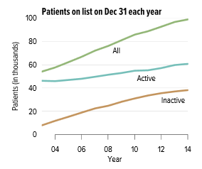
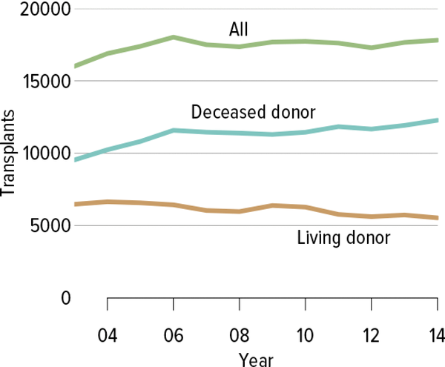
Demand >> Supply: Critical Organ Shortage
Roughly 100,000 patients waiting for a kidney transplant
National Statistics:
>3000 patients added to wait list each month
~13 people die per day while awaiting a kidney transplant
National average waiting time is more than 5 years for a deceased donor kidney!

Slide 7
Who should be considered for a kidney transplant?
All patients with ESRD (transplant discussion mandated by CMS)
Patients with advanced Chronic Kidney Disease
  Ideally should be evaluated early (well before starting dialysis). GFR must be <20 ml/min on at least one occasion to be actively listed (although patients can be seen before that)
  The best outcomes occur when transplant is done before starting dialysis (pre-emptive) or with minimal dialysis time
No fixed age restrictions
Transplantation is not a cure, but a treatment option for eligible candidates

Slide 8

Contraindications to transplant?
Absolute Exclusion Criteria
  Active Malignancy
  Active uncontrolled infection
  Unstable psychiatric or psychosocial condition (i.e. substance abuse, non compliance, inadequate social support, history of considerable non-compliance)
  Limited life expectancy
  Untreatable or advanced cardiovascular or pulmonary disease (CHF, CAD, CVA, PAD)

Slide 9
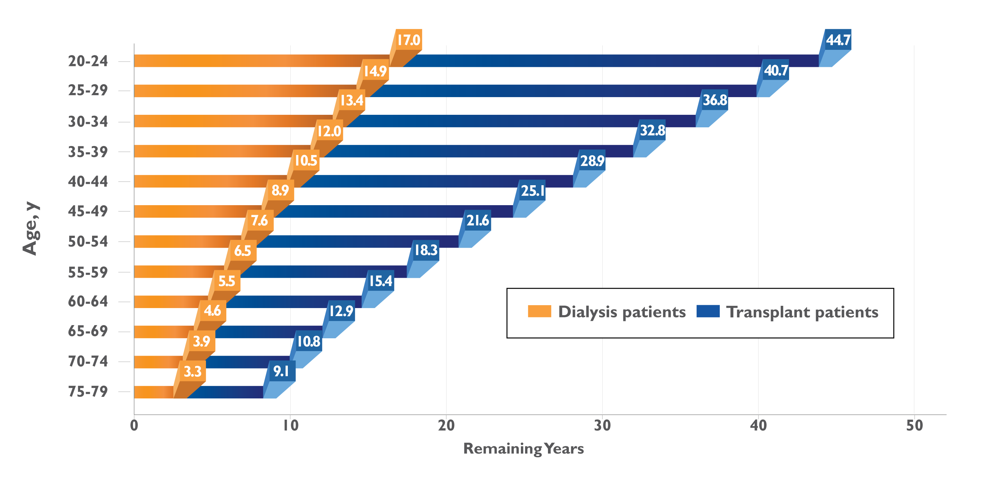
Recipients of a Kidney Transplant Have a Longer Life Expectancy Than Patients Who Remain on Dialysis
Expected remaining lifetime for recipients of a kidney transplant compared
with patients on dialysis (across sexes and various races)ª
Based on estimates from 2012, recipients of a kidney transplant
had about 2.5 times more remaining years of life than patients on dialysis
ª Data are from the United States Renal Data System (USRDS) 2014 Annual Data Report; estimates are from 2012.
USRDS. 2014 ADR chapters. http://www.usrds.org/2014/view/default.aspx. Accessed February 11, 2016.
Notes:
Recipients of a Kidney Transplant Have a Longer Life Expectancy Than Patients Who Remain on Dialysis
This slide shows the years of expected remaining lifetime for patients on dialysis (orange bars) compared with recipients of a kidney transplant (blue bars) in 5-year age increments
Based on estimates from 2012, recipients of a kidney transplant, regardless of age, can expect to have about 2.5 times more remaining years of life compared to patients
on dialysis
Similar trends were observed across genders and various races
Reference:
United States Renal Data System (USRDS). 2014 ADR chapters. http://www.usrds.org/2014/view/default.aspx. Accessed February 11, 2016.

Slide 10
The Kidney Transplant Team
YOU
Care Partner
Transplant Surgeons
Financial Coordinator & Pharmacy Counselor
Social Workers & Psychologists
Pharmacist & Dietitians
Transplant Coordinators and staff
Referring Physicians
Clinic Staff
Transplant Nephrologists & Nurse Practitioners
Notes:
Emphasize referring providers and bariatrics
Emphasize the Carepartner and the care partner contract and expectations.

Slide 11
Steps in the Evaluation Process
STEP 1
- Orientation (Today!)
- Testing
- Have potential living donors do online form/or call the office
- Exam and interview by transplant team
STEP 2
- Specialized testing
- Referrals to specialist
- Care partner secured and understands the role
STEP 3
- Review by the transplant committee

Slide 12
Blood Test
Diagnostic
Testing
Lung Testing
Colonoscopy
Mammo/Pap
Age
Appropriate
Cancer Screening
PSA blood test
Radiology Testing
Heart Testing
Physical Exam
Referral to Specialist if needed
Notes:
May have to see bariatrics

Slide 13
Cost of a Transplant
Medications
Travel
Lodging
Co-Pays for Visits/Labs
Hospital
Time Off Work

Slide 14
Financial / Pharmacy Questions
You are assigned a financial counselor and pharmacy financial counselor
Your pharmacy financial counselor will assist with prescription coverage post transplant and the benefit of using our Specialty Pharmacy at Nebraska Medicine that is dedicated to our transplant patients
You will meet with them as part of your evaluation to discuss insurance coverage
Ask questions:
- What will my out-of-pocket costs be?
- Do I need a supplemental insurance policy?
- Do I have travel and lodging benefits?
- How much will my medications cost?
You must inform the transplant team of insurance changes

Slide 15
Types of Transplants
Living Donor | Deceased Donor
Wait time is 2 to 4 months | Wait time is 1 to 3 years
Have a lower rate of delayed graft function | May have an increased rate of delayed graft function

Slide 16
Living Donor vs. Deceased Donor
Patient survival and graft survival is better (in other words, patients who receive a living donor kidney transplant live longer and have healthier kidneys that last longer)
The kidney is from a healthy person who has undergone a thorough medical evaluation
Surgery happens at the same time
Transplanted sooner when you have a living donor
The longer a person is on dialysis, the higher rate of medical complications. Living donation can happen sooner than waiting on a list therefore decreasing complications
Notes:
No medical benefit for the donor

Slide 17
1-, 5- and 10-Year Graft Survival Rates
Data from the USRDS 2014 Annual Data Report; 1-year data are from 2011, 5-year data from 2007, and 10-year data are from 2002.

Slide 18

Living Donors
Donor will complete a separate evaluation
Will have a different set of providers and decision makers to ensure it is safe to donate
We will not compromise
donor safety
Donor information is kept
confidential
Potential donors should fill out form online: nebraskamed.com/kidneydonor
Notes:
We will not discuss the living donor evaluation with you at all.

Slide 19
Living Donor Kidney Options
Donor is a match
Donor is not a match
Blood type and tissue type match
Blood type and/or tissue type not matching
Can be related or unrelated donor
Proceed to donor evaluation
Proceed to donor evaluation

Slide 20
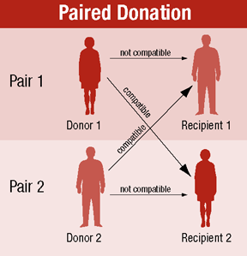
Internal Exchange Option

Slide 21
Types of Deceased Donors
Standard brain dead donor
Donation after circulatory death: (on life support, wait for the heart to stop then additional five minutes, no difference in long term patient or organ, survival or complications).
Public Health Services (PHS) Donor Risk Criteria: Many organs become available from donors who have been identified to have certain risk factors that may increase your chances for acquiring certain viral infections such as Human Immunodeficiency Virus (HIV), Hepatitis B and Hepatitis C. If an organ becomes available from a donor with a known PHS risk criteria (examples: IV drug use, jail time, multiple sexual partners, etc.), you will be told that it is a donor that meets risk criteria and that you have the option to decline the organ offer. Organs received from a donor meeting risk criteria does not imply that there will be reduced functionality of the organ. All transplant recipients are required to have blood drawn 4-8 weeks after transplant for HIV, Hepatitis B & Hepatitis C and results of the testing will be submitted to UNOS. If you test positive for any of these 3 tests, the transplant center will contact you to coordinate treatment.

Slide 22
More About PHS Risk Criteria Program Offers
The tests we use to look for HIV, Hepatitis B and Hepatitis C are extremely good, but as with every test, there is a small chance that the test is negative even if the virus is present.
A negative test might occur if the donor had a very recent infection. For this reason, we identify donors who have potential exposures for HIV, Hepatitis B and Hepatitis C in the last month that might be missed by our testing.
When offered a donor meeting risk criteria, you should also consider that your chance of dying while waiting for another organ offer may be greater than the risk of infection.
The risk of missing an infection is around 1 in 10,000 to 1 in a million depending on the risk criteria.
While this risk is very low, it is important for all organ recipients to know that a small risk exists and for this reason all recipients will be tested for these viruses after transplantation.

Slide 23
Types of Deceased Donors
Hepatitis B donors: (are offered to a patient who is immune to Hepatitis B either from prior exposure or vaccination)
Hepatitis C donors: You may be offered a kidney from a deceased donor who tests positive for Hepatitis C. You will have talked with a member of the kidney transplant team during your initial evaluation to be specially listed for these types of kidneys. A comprehensive medical assessment will be performed, including tests of your liver, to see if these kidneys are right for you. If so, post-operatively you will be given medical treatment if you contract hepatitis C and you may meet with a hepatologist. Post-operatively, in addition to your regular immune suppression medications, you may take 1 or 2 extra pills for a few months to eradicate the HCV virus. These pills are generally tolerated quite well, and are covered by your insurance. In general, accepting a kidney from a donor with HCV may significantly reduce your time on the waiting list, while ensuring excellent kidney allograft function in the future. The health of people who receive a kidney transplant is better than the health of people on long-term dialysis. This makes getting a kidney transplant the top priority. Since hepatitis C can be cured without too many side effects, this is now considered an option to transplant more people. At Nebraska Medicine, we have successfully transplanted over 50 people to date with HCV+ kidneys, all of whom have done well post-operatively from a viral standpoint.”

Slide 24
Types of Deceased Donors
Covid Positive Donors: You may be offered a kidney from a deceased donor who tests positive for Covid-19 or has previously been infected with Covid-19. During evaluation from the transplant team, which included input from our transplant infectious disease colleagues, we believe the risk of transmission of Covid-19 to you is very low as a kidney transplant recipient. To date, no confirmed transmission of SARS-CoV-2 from donor to recipient via non-lung organ transplantation has been reported; surveillance is ongoing. Long-term effects of utilizing organs from previously known Covid-19 positive donors is unknown.

Slide 25
Kidney Donor Profile Index (KDPI)
KDPI greater than 85%:
The national network (OPTN) is responsible for allocating kidneys and coordinating transplants
“Score” assigned to every kidney being offered for transplant its called Kidney Donor Profile Index this score is from 0-100%, this score is based on how the kidney will work:
  The score is made up of these donor factors:
  Weight
  Height
  Ethnicity
  Cause of Death (brain vs. head)
  Stroke as cause of death
  High Blood Pressure
  Diabetes
  Hepatitis C virus
  Serum Creatinine (a measurement of how the kidney is working)
  Age
  A person will be consented for Kidneys over the score of 85%
  We will not discuss the score of the kidney at any time. We will only notify you if the score is greater than 85%, which your consent is needed to accept this kidney
  Each offer is screened by the surgeons, this score is only one factor when accepting as offer
Notes:
Remind them they will not be given their exact score as it can change

Slide 26
KDPI
There are certain situations where a kidney will be given a high KDPI score that is not reflective of the actual quality of the kidney (ex: some pediatric kidneys or en bloc kidneys)
As such, limiting KDPI acceptance threshold has the potential to cause a candidate to miss out on some high quality donor kidneys that are expected to perform better than suggested by the KDPI
We recommend candidates are listed for all KDPI kidneys in order to increase the opportunity to receive a timely kidney transplant
  All donor kidneys are carefully screened by our surgeons to ensure the right kidney is given to the right patient
  Consent is required in order to be listed for kidneys with KDPI >85%

Slide 27
Possible Outcomes of Evaluation
Additional testing needed for team to determine candidacy
  Must be completed within 6-months of evaluation starting today
Placement on the Wait List
Not approved as candidate - risk of transplant outweighs potential benefits: Do No Harm
Notes:
Even though you have a living donor you must still be placed on the wait list per UNOS policy

Slide 28
Listing
If you are placed on the National Kidney Wait List managed by the United Network for Organ Sharing (UNOS), you will be notified via phone call and letter
The order on the list is driven by the length of time you are on the list, time on dialysis, antibody levels, and age (pediatrics)
The type of offer will be explained to you and you have the right to refuse a kidney offer.
NO Donor information will be shared

Slide 29
Wait List Responsibilities
Annual testing; however, some patients may be seen more often
Make sure you continue to have a reliable care partner with reliable transportation and a reliable cell phone at all times with voice mail.
  Monthly HLA Antibody testing
Notify your nurse coordinator of any changes:
  To your insurance, contact information which includes phone numbers, MEDICAL CONDITIONS, any dialysis changes, including changing nephrologists, travel plans

Slide 30
While on the Wait List
Exercise and Stress Management, Healthy Weight
Find a Living Donor
Update Yearly Testing
Send HLA Screens Monthly
Notify Team of Changes
Care Partner Intact
Medical Compliance/ Meds as Directed

Slide 31
Receiving an Organ Offer
We must be able to contact you within 15 minutes
You must have dependable transportation
Your care partner must come with you and be present during your hospital stay from 9:00-4:00
We will not share personal information pertaining to your donor at any time
There’s a possibility the transplant may fall through at any time

Slide 32
What to Expect When Called in for Transplant
When called with a transplant offer:
  We have 15 minutes to reach you or someone who will know where you are for the organ acceptance
  Primary offer
  Back up offer
  Coordinator will not discuss personal donor information with you
  We will inform you where to go and what to do when we call you in for transplant, you need to bring your care partner with you
Pack a bag to include:
  Bottles of home medications
  All recipients need to anticipate staying in the Omaha area for 6 weeks post transplant. Your individual stay will be dependent on your transplant admission course. Your length of stay in the Omaha area will be discussed at your first clinic visit. Omaha area is considered 1 hour away from the transplant center.
Notes:
Explain what primary and backup for offers means.
The transplant may fall thru even in you are already in pre-op.

Slide 33
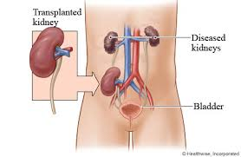
The Surgery
2-3 hour surgery
Kidney attached in the front of body, near the bladder
Will stay on Clarkson’s 5th floor
Usual hospital stay is
3 to 4 days
Up and moving same day of surgery
A ureteral stent will be placed and removed six weeks after transplant in an outpatient procedure
A foley catheter will be placed and removed post op day 3
Follow your clinical pathways inpatient

Slide 34
Potential Outcomes of Transplant
☺ = Kidney works immediately (70-80%)
😐 = Slow or delayed graft function; you may need dialysis after transplant (20-30%)
☹ = Fail immediately (1%)

Slide 35

Complications from Transplant
Surgical:
Bleeding
Wound complications
Fluid collections
Urinary complications
Medical:
Infections
Rejection
Weight gain
Diabetes
Cancer
Hypertension
GI side effects

Slide 36
Daily Bathing Decreases Infection
All people have harmful germs or harmful bacteria on their body
These germs and bacteria can cause infections after surgery
You will be asked to take a shower at the time of admission for surgery
You will be asked to shower daily following your surgery
Taking a shower prior to surgery and a shower daily following surgery CAN prevent infection

Slide 37
Post-Transplant Compliance
Clinic Visits
Reestablish post-transplant care with your local nephrologist at 6 months
Lab Work
1st month = Every Monday and Thursday
2nd – 4th month = Weekly
4th – 12th month = Bi-weekly
Medications
Twice a day
Take anti-rejection/immunosuppressant meds for life
Unexpected Admissions
Transplant team keeps a close eye on you
1 week post discharge with the team
Monthly with transplant nephrologist or APRN at months 1, 2, 3, 6, 9, 12, then annually
*Please note that visits and lab draws may vary depending on your kidney.

Slide 38
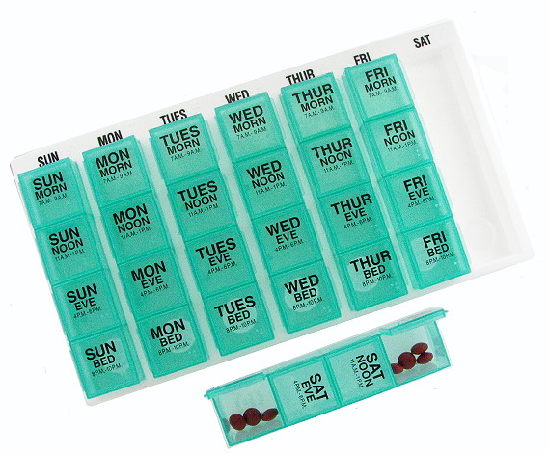
Medications for Transplant
3 anti-rejection/immunosuppression medications:
  Prograf
  Myfortic/Cellcept
  Prednisone
3 anti-infective medications:
  Bactrim
  Valcyte
  Nystatin
Other medications for:
  Hypertension
  Gout
  Diabetes
  Cholesterol
  Heartburn
  Total Medications: 10 to 18
  You can not CRUSH, CHEW OR BREAK your antirejection medications

Slide 39
Pancreas Transplant
Only pertains to Type 1 diabetics
Evaluation similar to that for kidney transplant
Options include pancreas transplant alone, or simultaneous kidney-pancreas, if renal failure present
Longer operation, more extensive surgery than kidney transplant alone
Higher risk of early failure
Medications and long-term risks similar
Notes:
Only pertains for diabetics
“kidney” transplant in last line

Slide 40
Important Information
We are recommending that all our patients receive their Hepatitis B vaccine prior to transplant. The hepatitis B vaccine is a vaccine that prevents getting hepatitis B if you are exposed. It is a requirement from United Network of Organ Sharing that a discussion with your transplant team takes place with our recommendations.
You will receive a transplant education book, blood pressure machine and a thermometer during your hospital stay.
You must contact your pharmacy 7 to 10 days in advance for refills.
You will take your medications AFTER your lab draws.
You will need to take your blood pressure/heart rate twice a day morning and night, morning temperature, morning weight. This information will be reviewed with your transplant team during clinic visits.

Slide 41
Transplant Outcomes
For updated Scientific Registry for Transplant Recipients (SRTR) data visit us online at: www.nebraskamed.com/transplant

Slide 42
Repay the Gift You are Given
Take your medications
Have your labs drawn
Go to your physician appointments
Maintain relationship with your local nephrologist
Call if you have questions:
Toll free: 1-800-401-4444 or
(402) 559-5000

Slide 43
Expectations During Visits with Care Providers
During your evaluation/interview today, various team members may be asking about the following issues:
  Financial situation
  Medical history
  Psychosocial situation
All discussions remain confidential within the transplant team.
If there are items that you do not feel comfortable discussing in front of your care partner, please let us know if you would like your care partner to step out during certain discussions

Slide 44
Next Steps
Sign evaluation acknowledgement and listing letter of understanding
Finish your evaluation and ask questions
Make sure a care partner is present throughout the process
Find a living donor!
Follow your medical recommendations from your nephrologist and/or dialysis team
Get the word out and share your story

Slide 45
Quiz
Are you on the kidney transplant Wait List by coming to this appointment?
What is the website you should refer living donors to?
Will you have more testing to complete?
Will you have to do anything while on the list?
Does transplant cure end-stage renal disease (ESRD)?
Does your care partner need to be present with your during your evaluation and transplant?

Slide 46
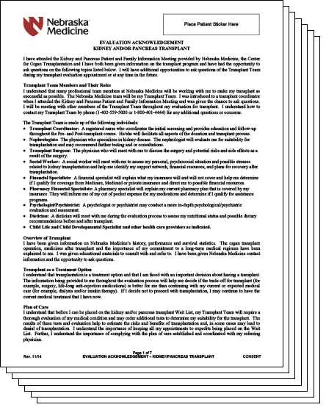
Consent Forms
Evaluation
Acknowledgement Form

Slide 47
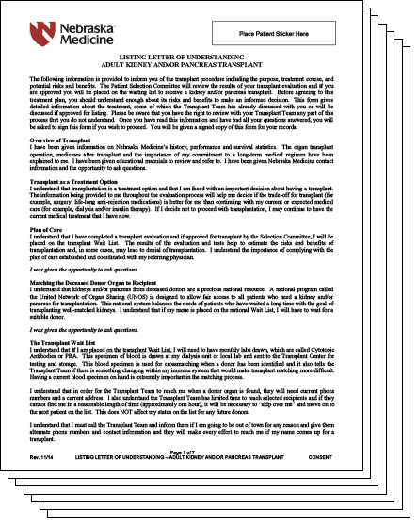
Consent Forms
Listing Form

Slide 48
Questions?

